Slide 1


COMPLETE RTOS
Author: Prashanth Rajasekar
Embedded Software Engineer
Intern @ CTI One Corporation

Slide 2
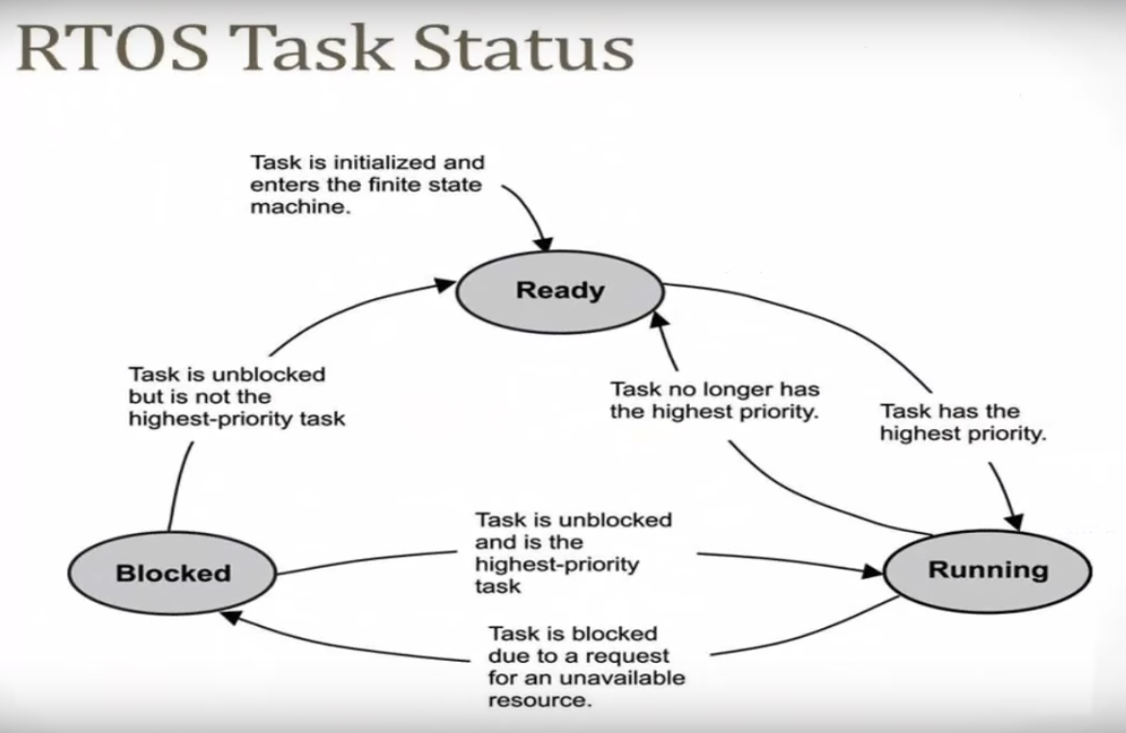
ROAD MAP

Slide 3
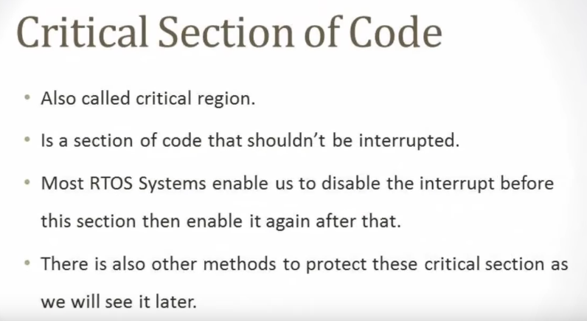
ROAD MAP

Slide 4
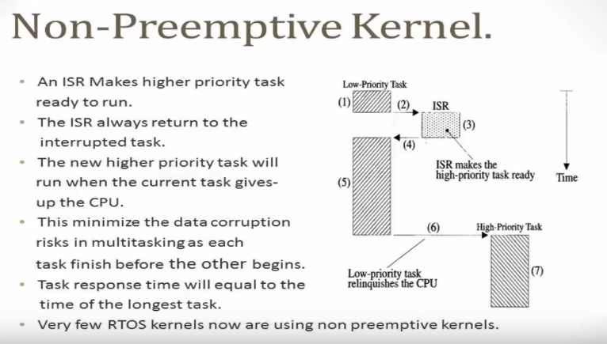
ROAD MAP

Slide 5
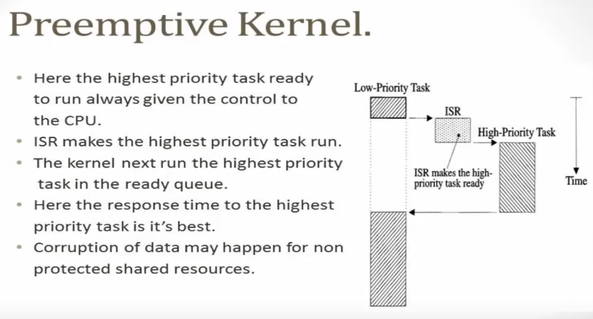
ROAD MAP

Slide 6
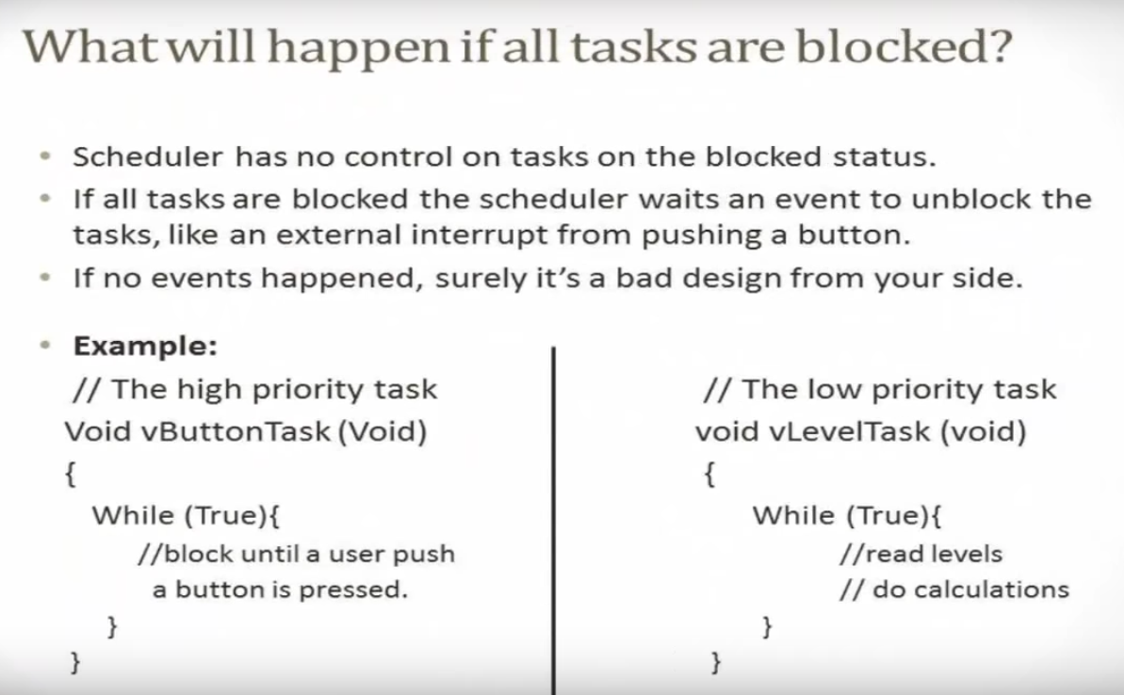
ROAD MAP

Slide 7
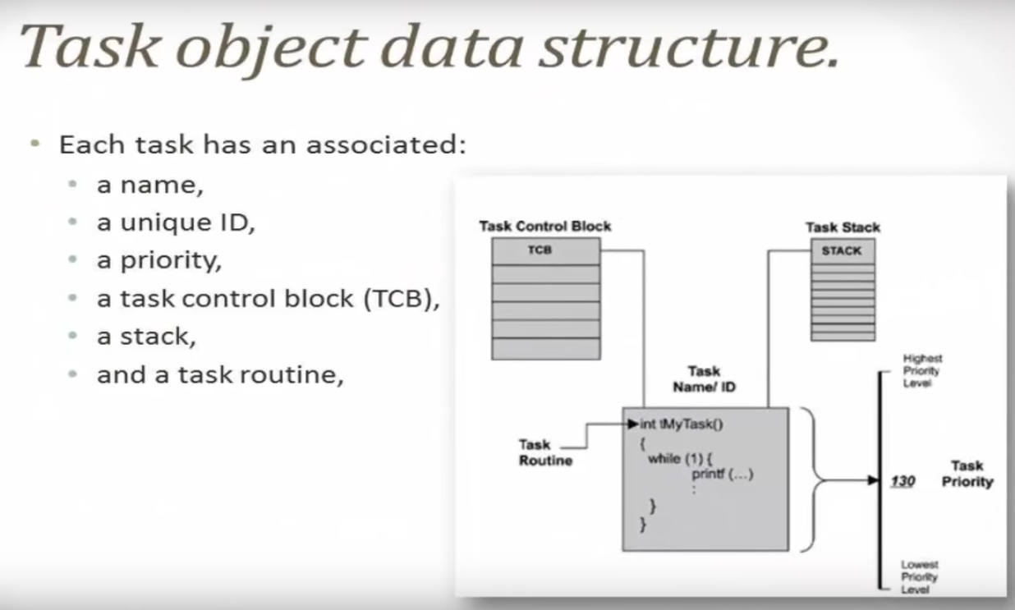
ROAD MAP

Slide 8
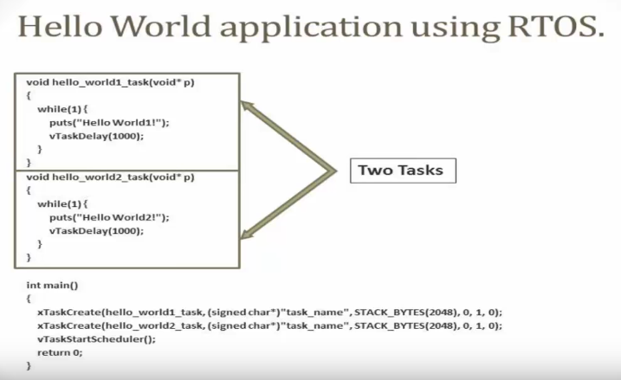
ROAD MAP

Slide 9
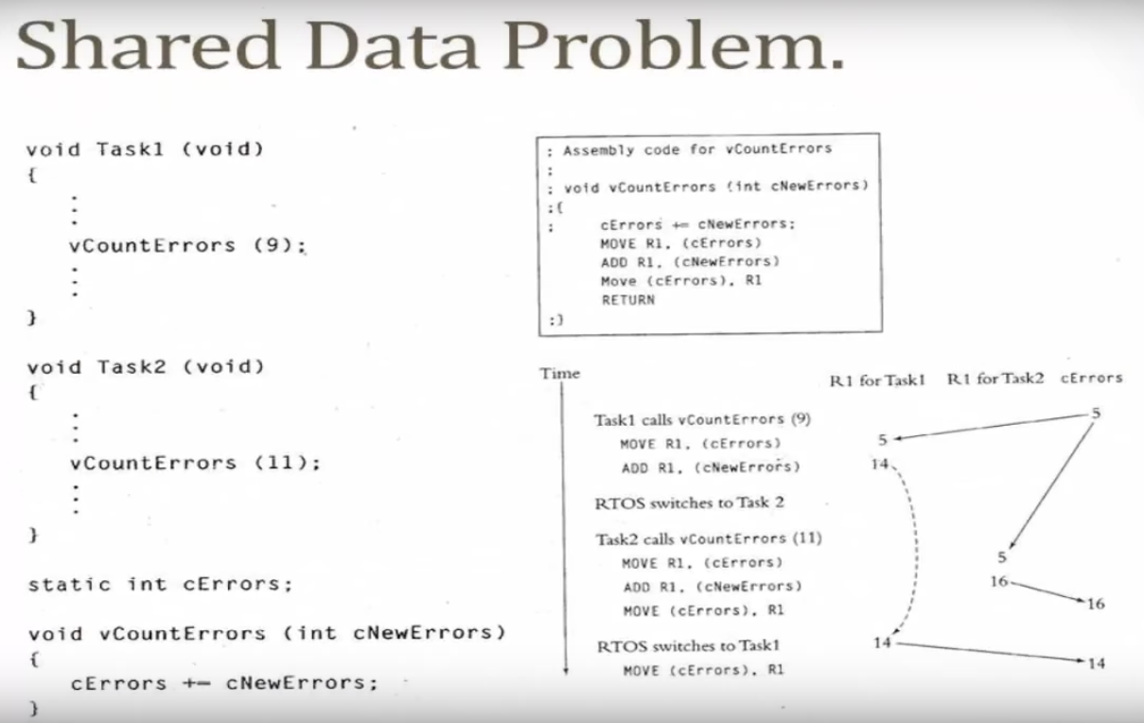
ROAD MAP

Slide 10
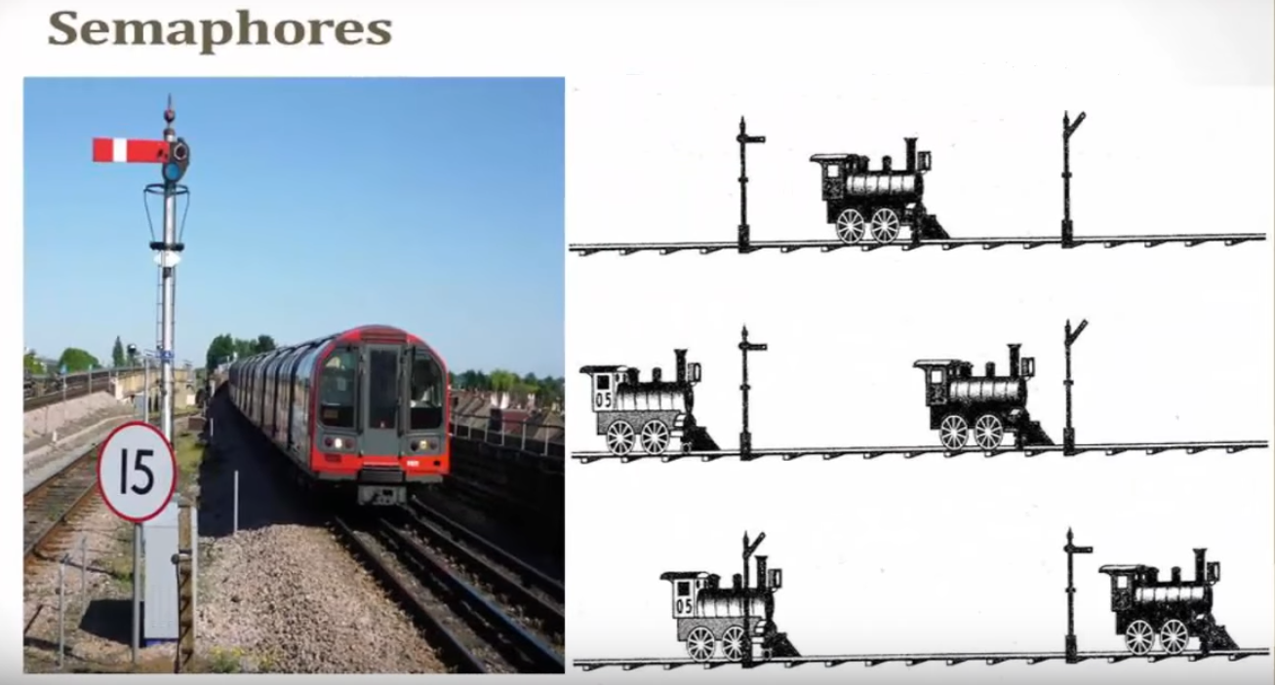
ROAD MAP

Slide 11
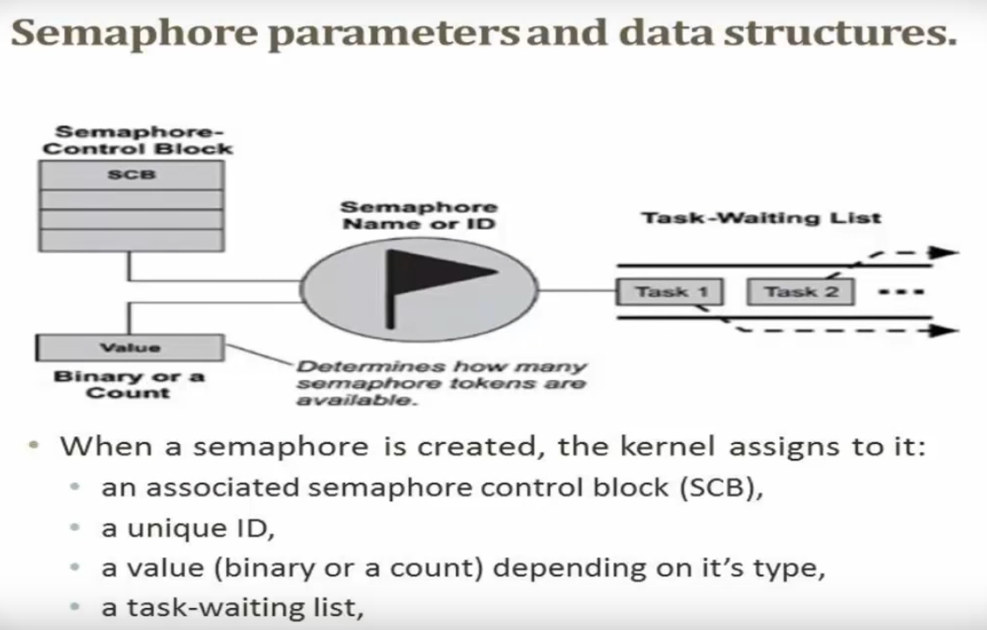
ROAD MAP

Slide 12
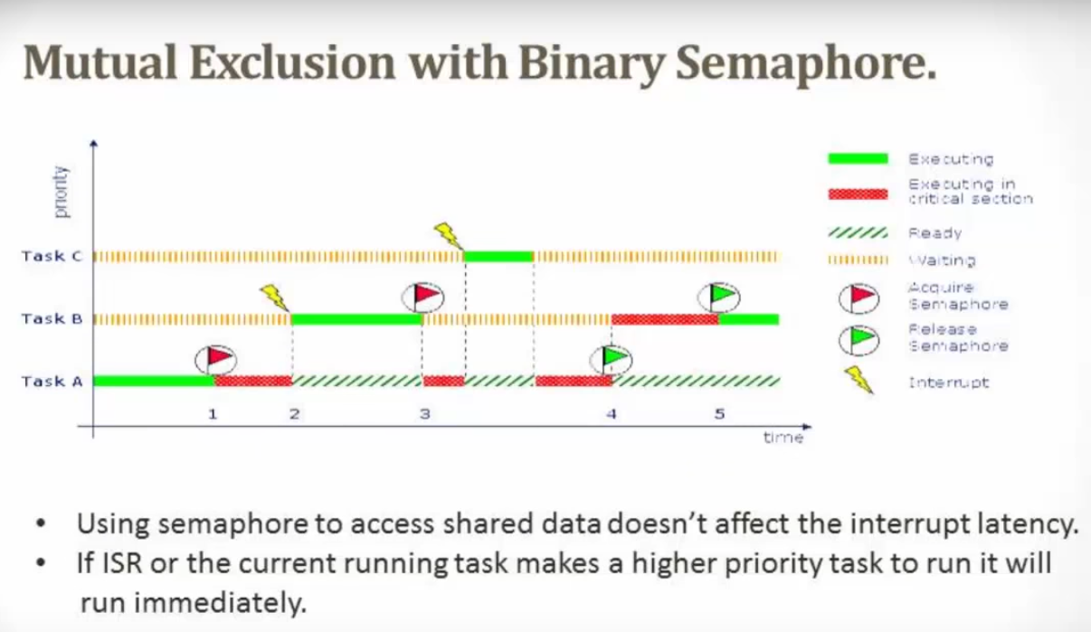
ROAD MAP

Slide 13
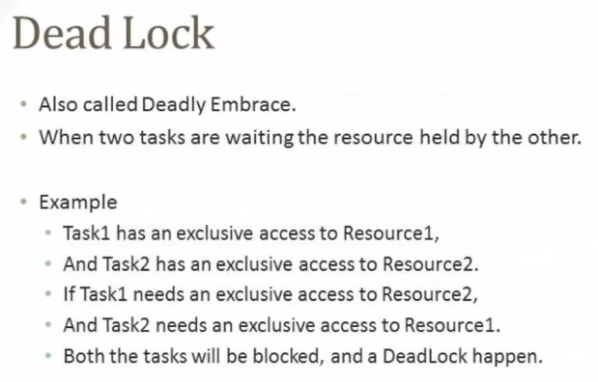
ROAD MAP

Slide 14
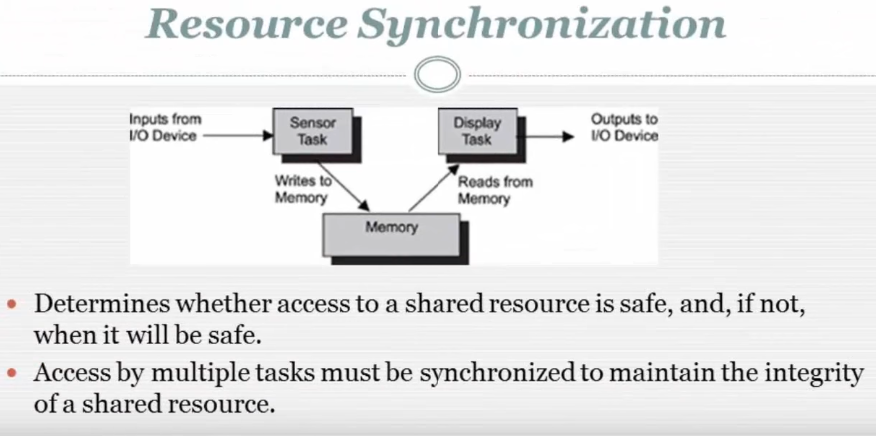
ROAD MAP

Slide 15
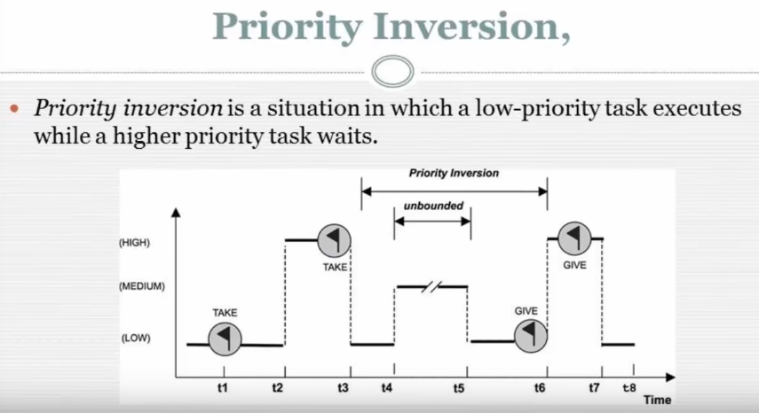
ROAD MAP

Slide 16
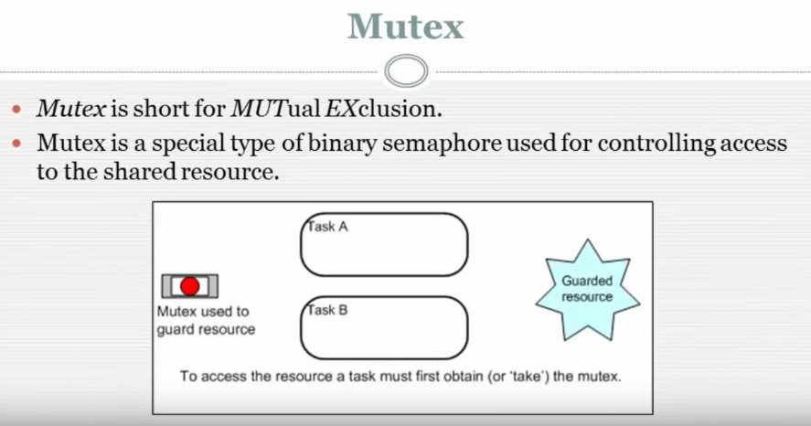
ROAD MAP

Slide 17
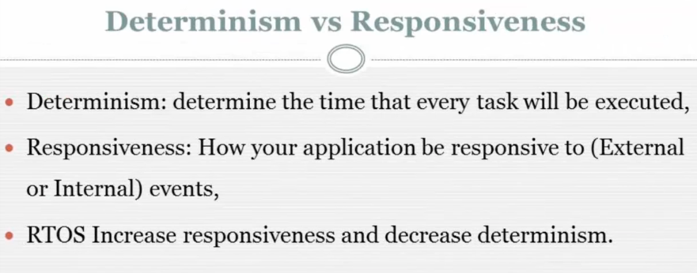
ROAD MAP

Slide 18
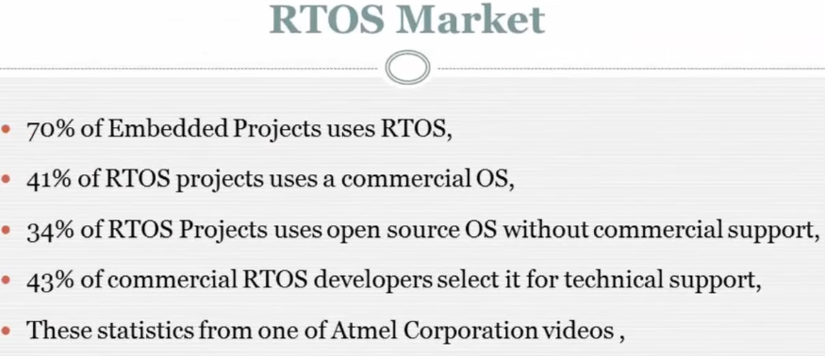
ROAD MAP

Slide 19
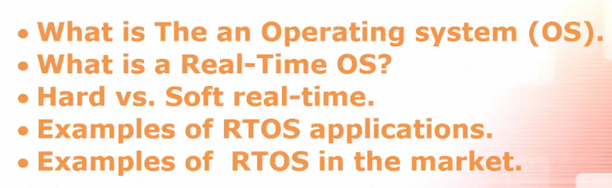
ROAD MAP
Chapter - 1

Slide 20

ROAD MAP
Chapter - 2

Slide 21
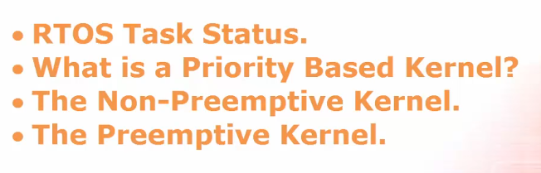
ROAD MAP
Chapter - 3

Slide 22
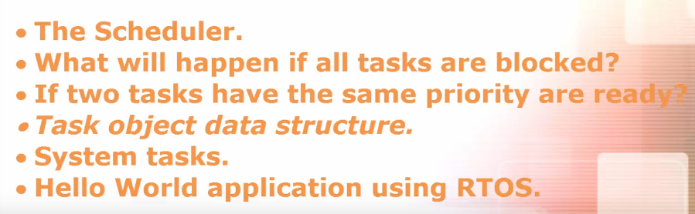
ROAD MAP
Chapter - 4

Slide 23
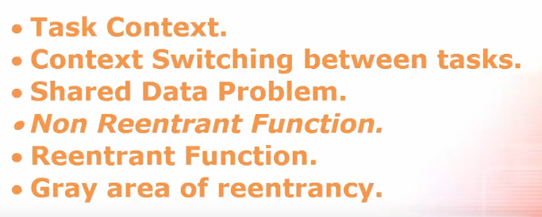
ROAD MAP
Chapter - 5

Slide 24

ROAD MAP
Chapter - 6

Slide 25

ROAD MAP
Chapter - 7

Slide 26
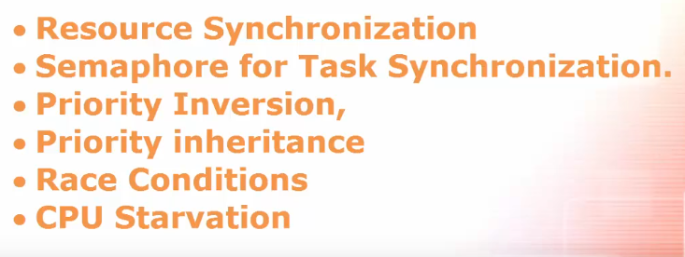
ROAD MAP
Chapter - 8

Slide 27
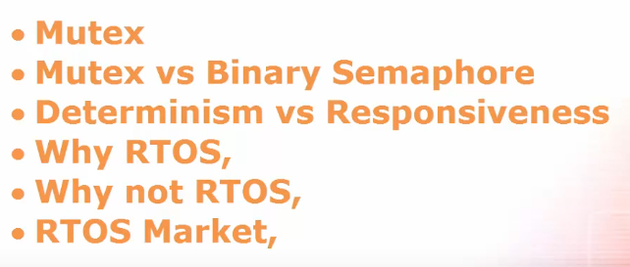
ROAD MAP
Chapter - 9

